Slide 1

ANGULAR 2

Slide 2
PROGRAMA DA FORMAÇÃO
Architecture, What's New, and What's Different
Angular 1's Impact
Angular Modules
Controllers to Components
Structural Directives
Data Binding
Less Built-in Directives
Services
Dependency Injection

Slide 3

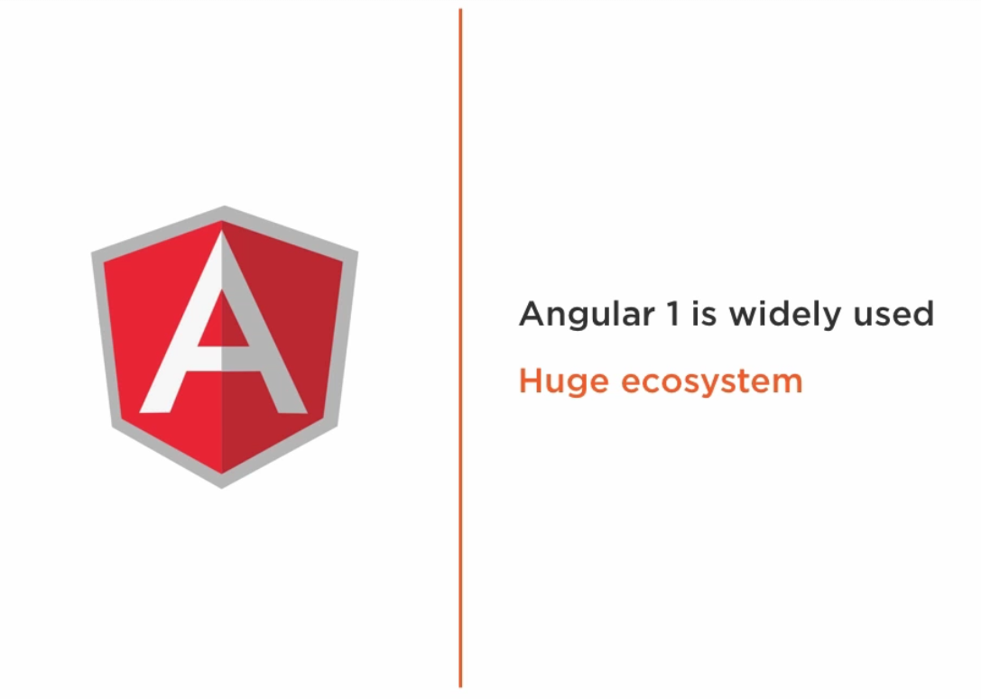

Angular 1's Impact
Others

Slide 4
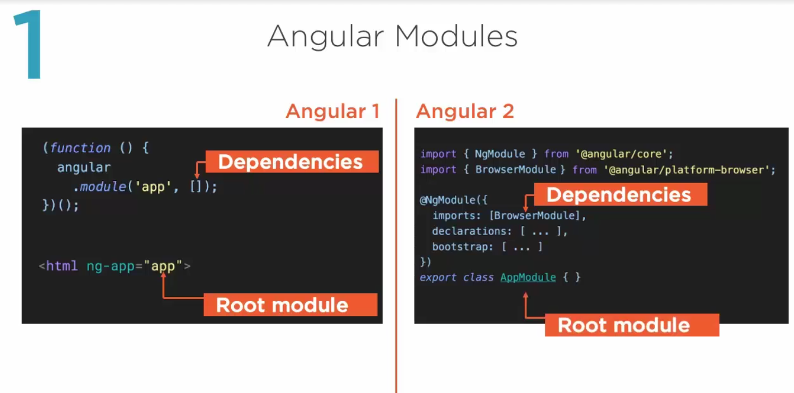

Slide 5
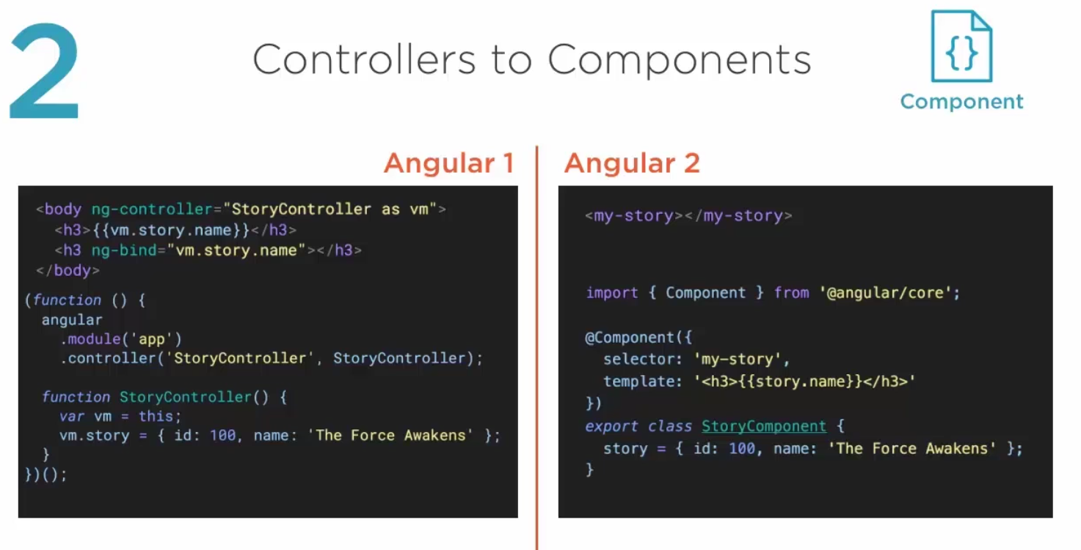

Slide 6
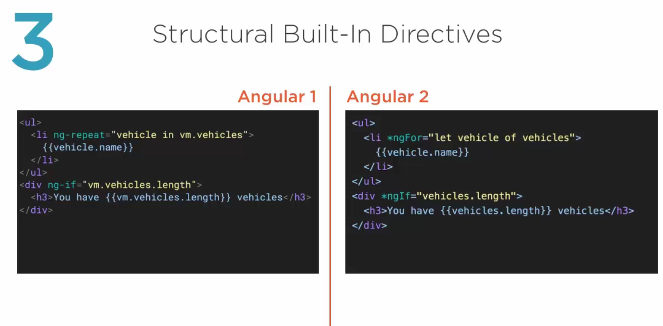

Slide 7
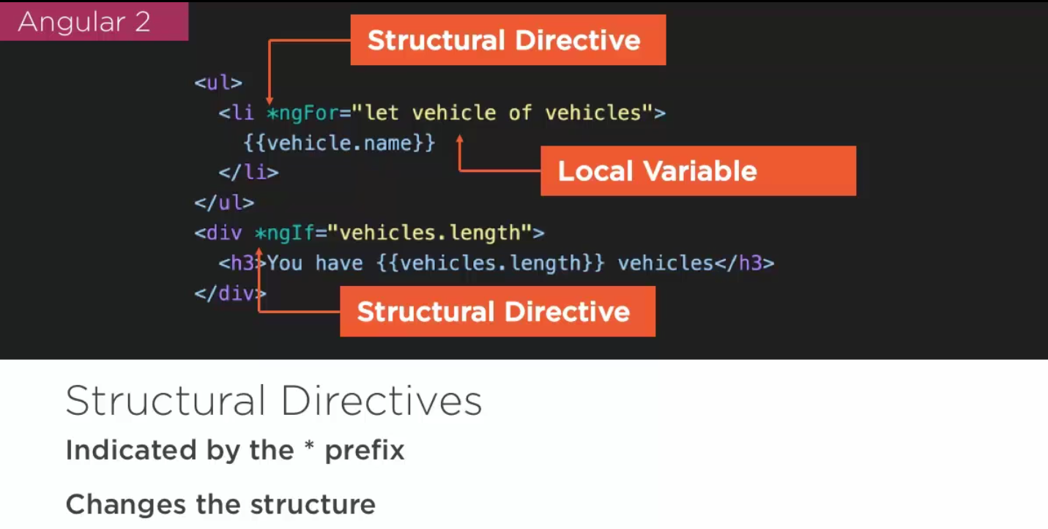

Slide 8
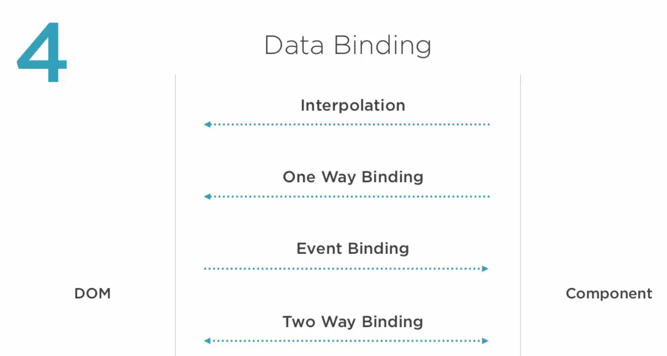

Slide 9
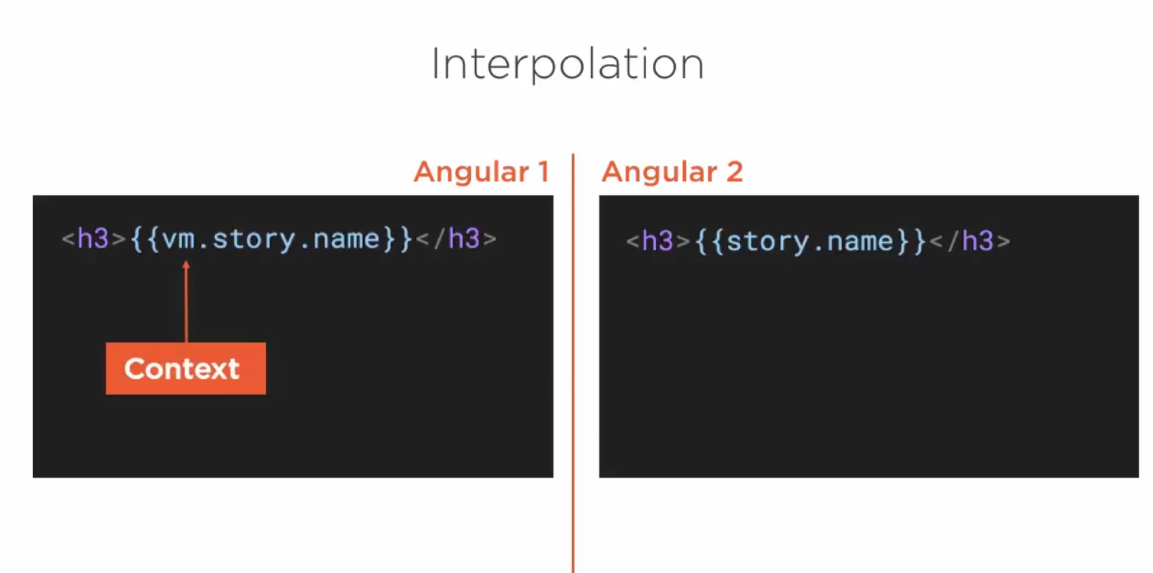

Slide 10
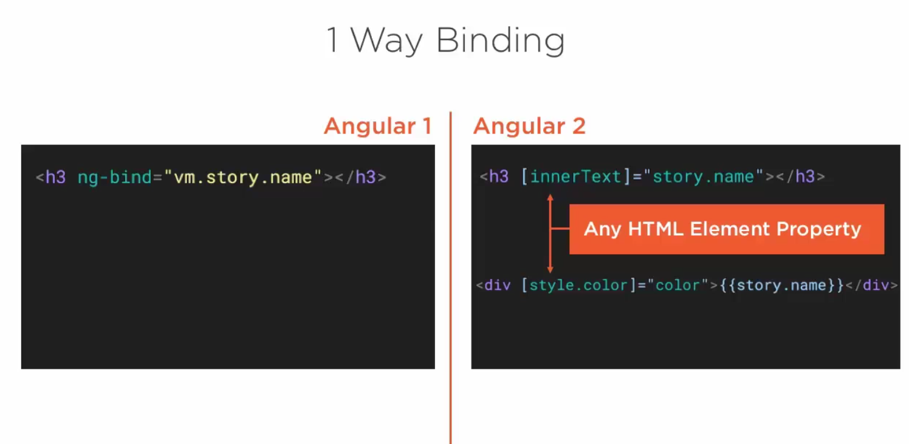

Slide 11
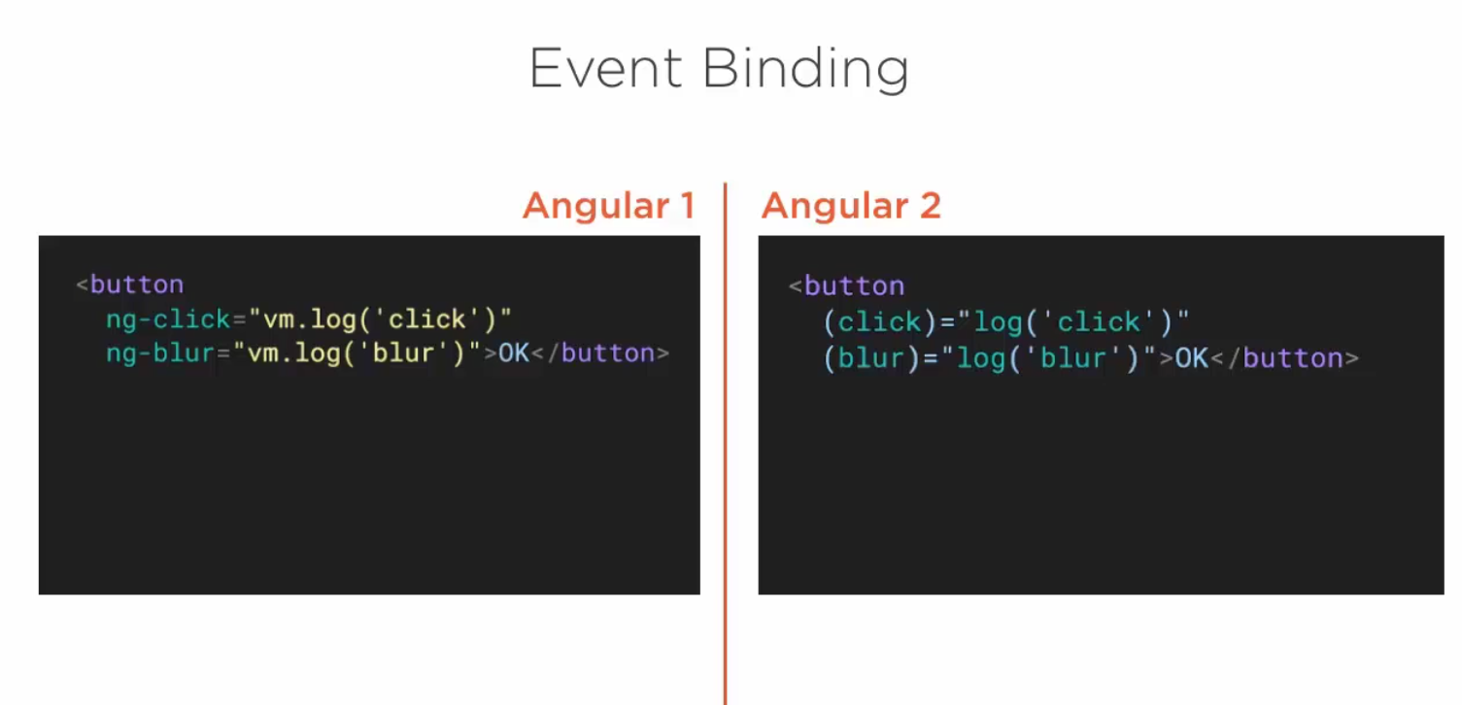

Slide 12
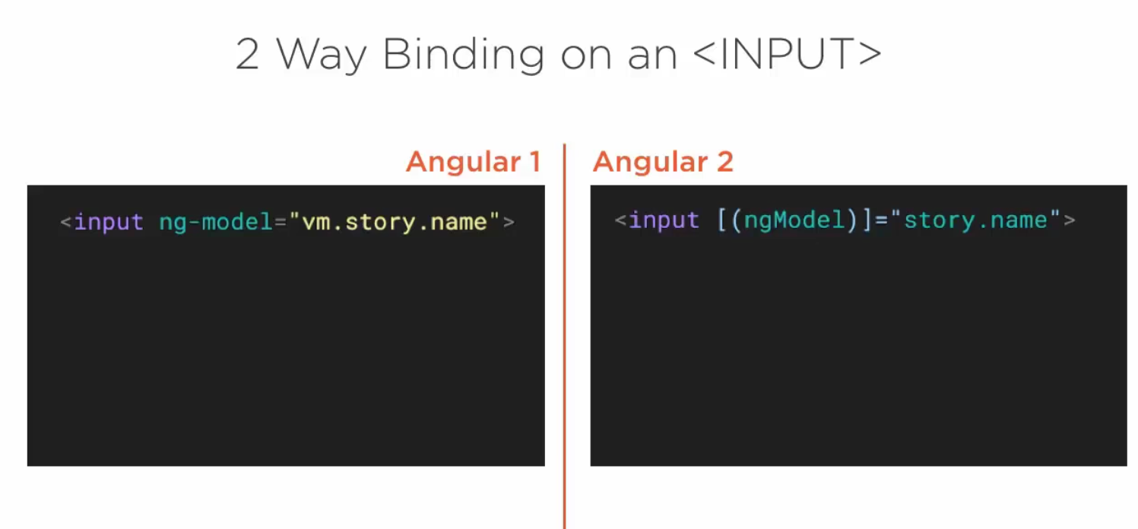

Slide 13
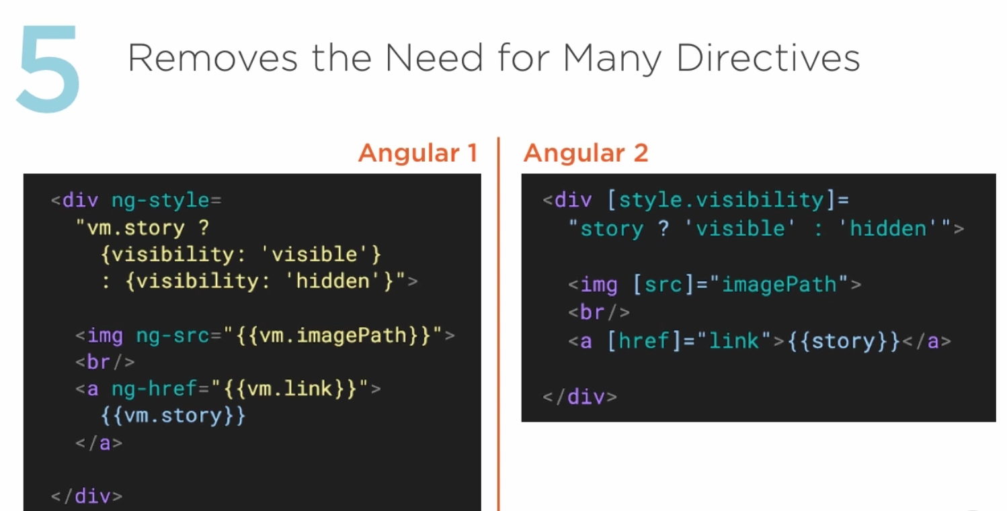
Less Built-in Directives

Slide 14
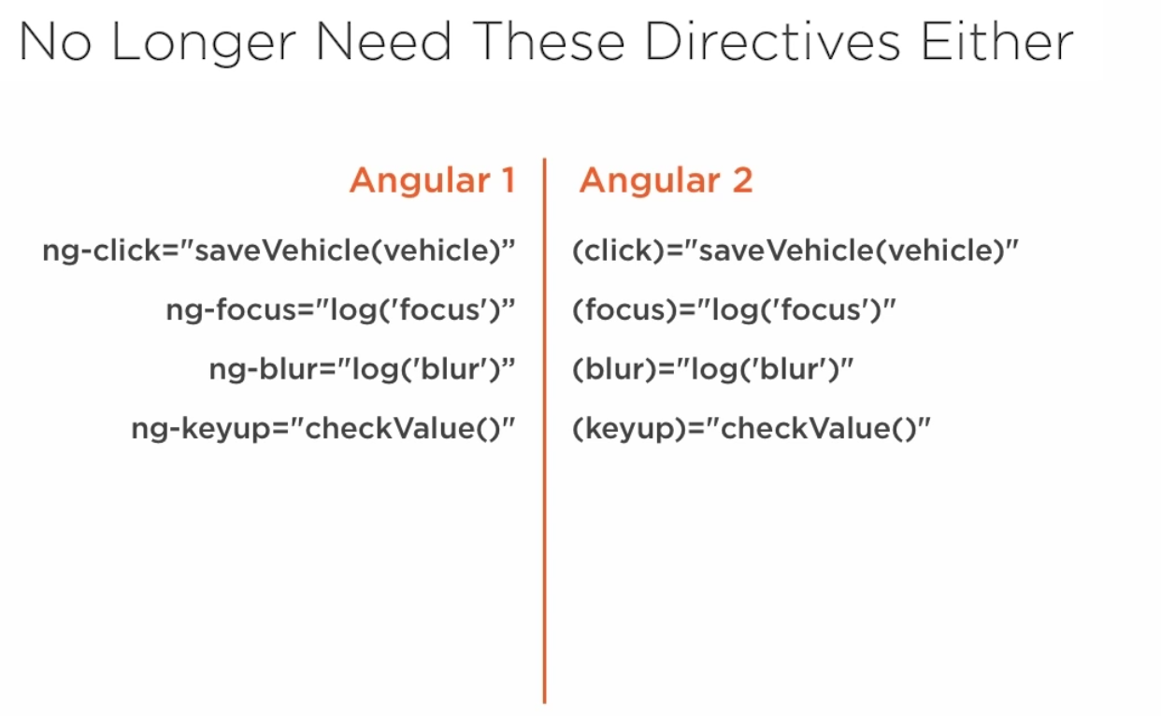
Less Built-in Directives

Slide 15
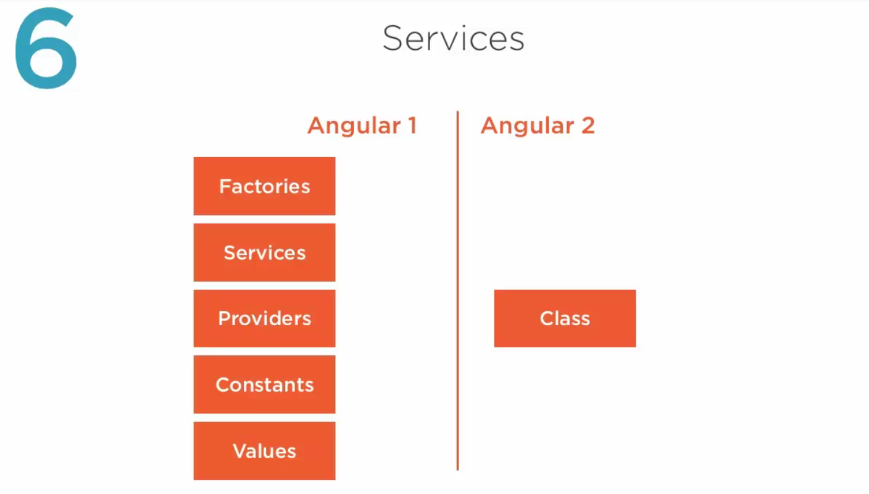

Slide 16
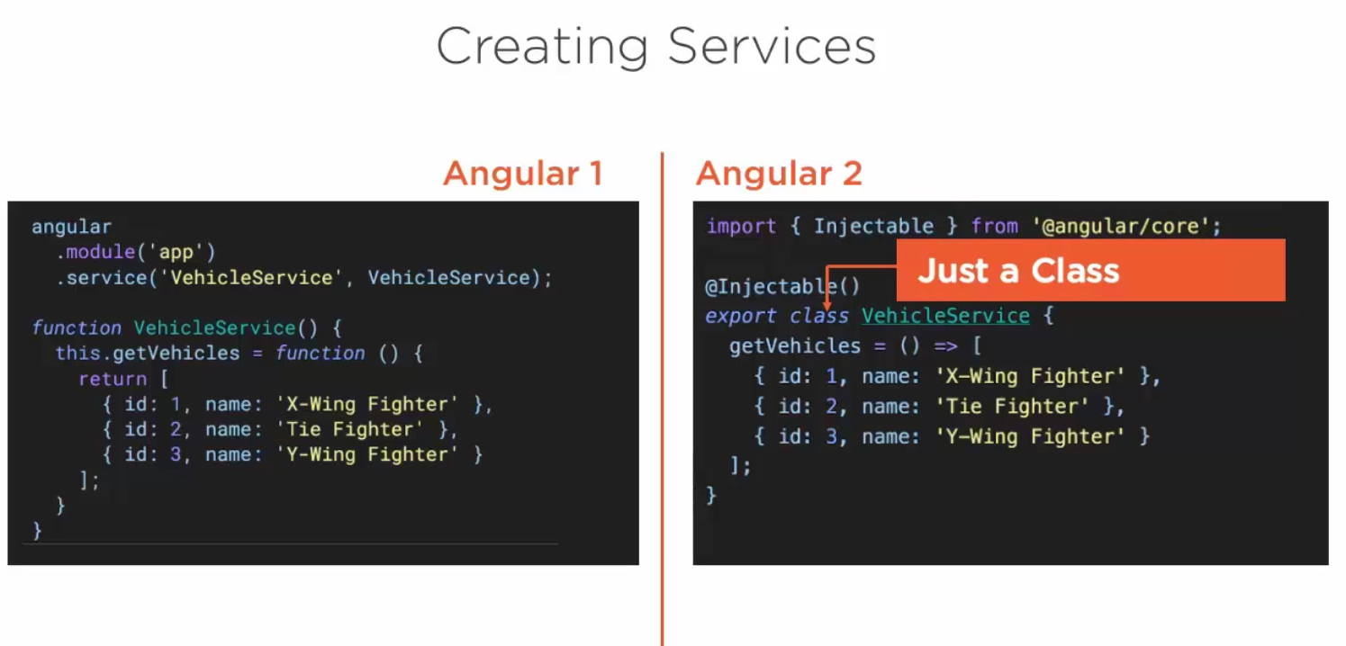

Slide 17
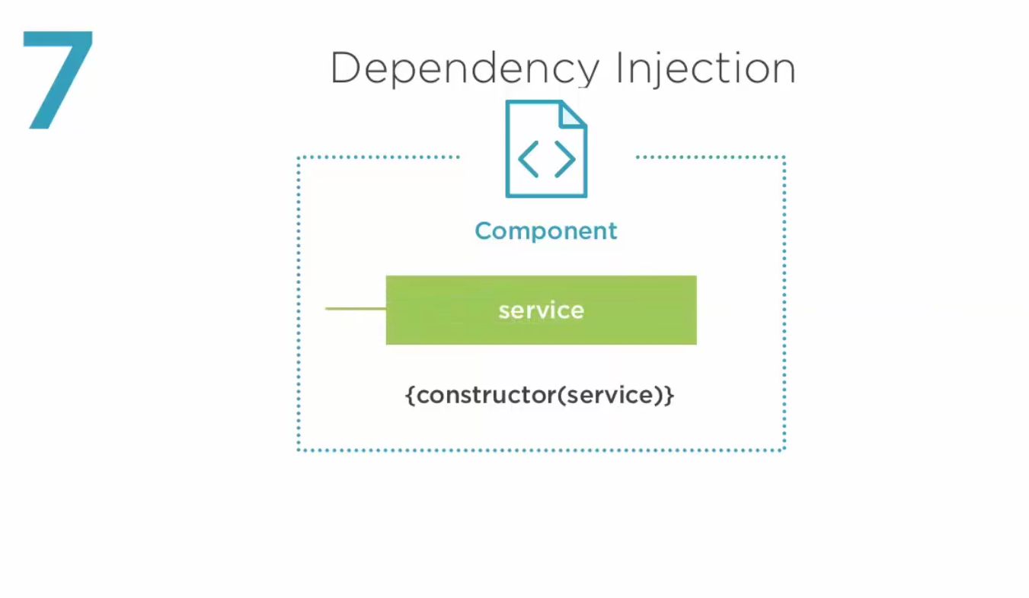

Slide 18
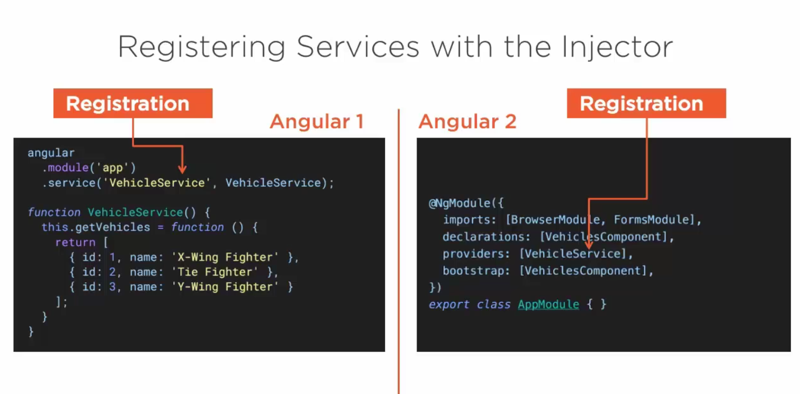

Slide 19
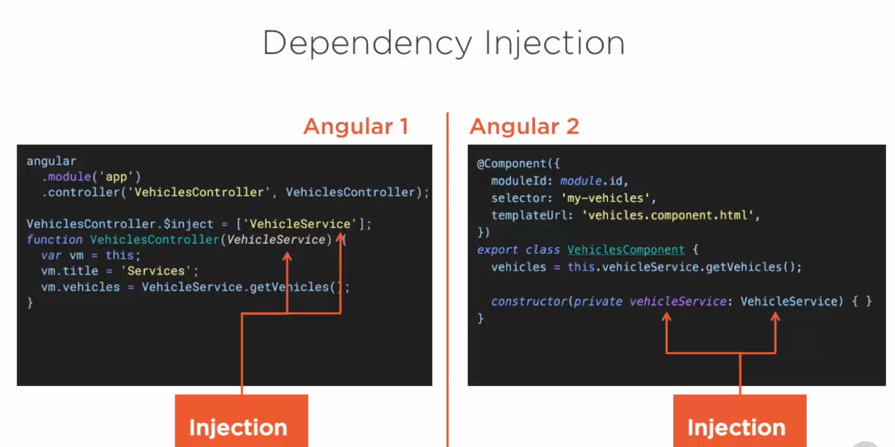

Slide 20
LAB 1
Take advantage of your first application and change the first page to display a list of the main characters of the starwars movies. When you click on one character, his name should be highlighted on a h2 tag.

